Slide 1

Wei Dang
Kevin Ellsworth
Cory Shirts

Slide 2

Goal: have a user interface to allow user text input using sign language
  User interface
  Development of the algorithm
  Demonstration

Slide 3

Include screenshot,
Notes:
Explain the screenshot and briefly describe the layout of the GUI

Slide 4
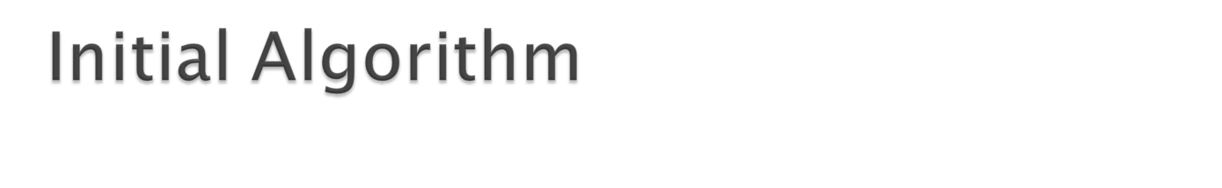
Perform thresholding on a small ROI (maybe a block diagram here would be better)
Match thresholded templates to this ROI
Return the best match or average from a set of templates
Result: did not fit well with similar signs

Slide 5


